Slide 1
Public Library Privatization:
Evading Civic Responsibility
Whitney McCoy, MLIS Candidate

Slide 2
Public Libraries: Investing in Us
“Forming communities and collaboration is the core of what libraries do.”
-President Walter Isaacson, Aspen Institute

Slide 3
Public Libraries: Investing in Us
Characteristics of public libraries:
Supported by taxes (mostly local)
Governed by a library board to serve the public interest
Open to all, and collections are accessible to every member of a community
Provide basic services without charge
(Rubin, R. E., 2010, Foundations of Library and Information Science)

Slide 4
Public Libraries: Investing in Us
Public library funding:
"Public libraries have long relied on local funding sources. According to a recent Institute of Museum and Library Services public library survey, nearly 85 percent of all public library operating revenue comes from local sources, including general revenue funds, dedicated property taxes, voter-approved taxes and a portion of sales taxes." - Garmer, A. (2014)
Locally-funding libraries keeps taxpayer dollars in the local community
Public libraries should not be viewed as an expense, but as an investment
An ALA study found that for every $1 spent on public libraries, the local community receives $5.48 in economic value (ALA, 2017)
The average U.S. citizen spends $36.96 annually in taxes for the public library

Slide 5
Public Libraries: Investing in Us
Public Library Ethics and Mission
Curate an unbiased, diverse collection of materials reflecting multiple perspectives and points of view
Promote literacy and lifelong learning at all stages of development
Identify and remove barriers to information access to all
Serve as a cornerstone of democracy by protecting intellectual freedom: “the right of every individual to both seek and receive information from all points of view without restriction. It provides for free access to all expressions of ideas through which any and all sides of a question, cause or movement may be explored.” (ALA, 2017)
Notes:
It is absolutely critical, in a time when the public trust in government is extremely low from local governments up to you-know-who, that we recognize libraries as the democratizing force that they are. Libraries are a critical component of maintaining a literate, informed citizenry. Public libraries also are staunch defenders against censorship, and in this era of “fake news”, they have taken on a role of teaching information literacy in addition to traditional literacy skills.

Slide 6
Public Libraries: Investing in Us
“Google can bring you back a hundred thousand answers. A librarian can bring you back the right one.”
- Neil Gaiman
Notes:
It is absolutely critical, in a time when the public trust in government is extremely low from local governments up to you-know-who, that we recognize libraries as the democratizing force that they are. Libraries are a critical component of maintaining a literate, informed citizenry. Public libraries also are staunch defenders against censorship, and in this era of “fake news”, they have taken on a role of teaching information literacy in addition to traditional literacy skills.

Slide 7
Public Libraries: Investing in Us
Why do we need librarians?
Highly educated, Master’s degree-holding civic servants
Skilled professionals who are trained in protecting intellectual and civic rights, teaching literacy and technology skills, and providing services to diverse populations
They serve our community because they are part of it!
Librarians create service plans targeted to groups that are marginalized, disenfranchised, and overlooked: people experiencing homelessness, adults who struggle with literacy, teenagers, new immigrants, non-English speakers, young children, unemployed people, etc.

Slide 8
The Escondido Public Library
Cornerstone of our community since 1894
Service population of 150,760 people -- 36,028 are children under 14
447,827 visits in 2015-2016: 1,435 visitors per day!
53 employees and 25 FTE volunteers
17,133 people attended 410 programs
80,360 annual uses of public computers
Total materials collection of over 200,000 items
EPL’s budget comprises only 3% of Escondido’s general fund budget (Diaz, O., 2017, https://www.times-advocate.com/articles/keep-the-escondido-public-library-public/)
Source for EPL Statistics: CA State Library
Notes:
And to think that some people actually say “no one uses the library anymore!”

Slide 9
The Escondido Public Library
Spending
Office of City Manager has pointed to Grand Jury report indicating that the library does not adequately meet the needs of Escondido as a reason for exploring privatization (Library Board of Trustees Meeting, 7/11/17)
What the report actually says:
“Unused allocated funds from the Escondido Library operating budget are not used to benefit the library.” (San Diego County Grand Jury Report, 2017)

Slide 10
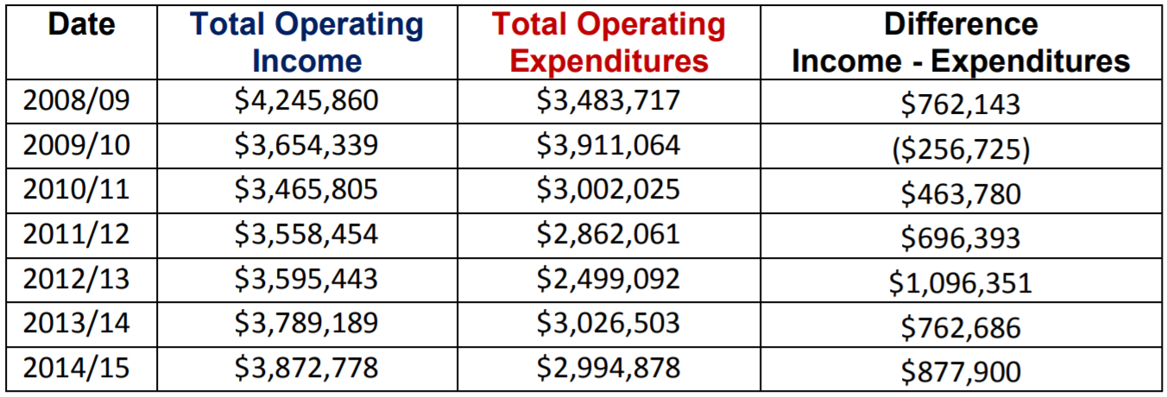
The Escondido Public Library
Unused allocated funds?
San Diego County Grand Jury, 2017, Table 1, page 7
Notes:
This is not about saving money by cutting costs or reducing overhead. Operations expenditures have nothing to do with it. As our City Manager made clear at the Library Board meeting this month, this is about forcing library staff off of the CalPERS retirement system and ensuring that the City won’t have to pay for library staff salaries or benefits in the future.

Slide 11
Library Systems and Services, LLC
“If you're looking for a sign that local political leaders are intent on giving up all pretense of working for the public interest, look no further [than the outsourcing of public library management].” - Michael Hiltzik, LA Times, 2016
Private, for-profit company that manages municipal libraries via outsourcing
Not supported by the ALA; see ALA Policy Manual B.8.8
Based in Maryland
As a private company, nothing forces them to disclose profits, salaries of CEO and Board of Directors, employee pay and benefits, etc.

Slide 12
Library Systems and Services, LLC
Made claims that savings come from bulk buying of materials, eliminating low-circulating materials, reducing overhead costs, and increasing efficiency (Library Board of Trustees meeting, 7/11/17)
Actual savings come from employee pay that is much lower than the industry average, poor employee benefits, and insufficient expenditures to meet community needs (Martin, R.S., ALA Report on Outsourcing, 2000)
Savings are not returned to the local community -- this is a for-profit company

Slide 13
Library Systems and Services, LLC
Founded by Frank Pezzanite, who said that “A lot of libraries are atrocious. Their [employment] policies are about job security. You can go to a library for 35 years and never have to do anything and then have your retirement. We’re not running our company that way.” LA Times
Another quote: LSSI prefers to have full control of all library employees because “We have much more control. We can incent them. If an employee does a good job, we like to give them a $5 gift certificate to Borders Books or Mrs. Fields.” Library Journal

Slide 14
Library Systems and Services, LLC
In 2006, ahead of his retirement, Pezzanite sold a majority stake in the company to Islington Capital Partners, a Boston private equity firm, in an undisclosed multi-million dollar deal. LSSI projected $23 million in sales that year. Source
In 2015, Argosy Private Equity acquired a controlling ownership interest in the company, stating that LSSI fit their model for “value acceleration.” Investment partners from Argosy were given Board of Directors positions at LSSI as part of that deal. Source
Santa Clarita’s 3 branch system was LSSI’s first acquisition of a library not in distress: $4 million deal for initial contract (Source)
Is this where we want our local taxpayer money to go?

Slide 15
Riverside County Library
LSSI manages operations at all 37 service points of the Riverside County Library System, and presents this system as the poster child of their services
Important to note: Riverside County transferred operations to LSSI as a last resort instead of shutting down their library system entirely following an economic crisis in the 1990s (ALA, 2000)
ALA report: LSSI’s materials budget is “still inadequate to maintain the branch library collections, which are in the main too small for the populations they are intended to serve, and are generally old and worn. The few branches whose collection appears in better condition have clearly benefited from infusions of additional local funds.” (ALA, 2000)

Slide 16
Riverside County Library
ALA survey of RCLS employees:
“Only fifty-six percent thought that their work schedule enabled them to get their work done in a professional manner”
“Staff turnover appears to be significant among newer employees”
“LSSI has demonstrated a willingness to hire staff without professional qualifications to perform functions that had previously been performed by professional librarians”
“forty-three percent of [library staff] surveyed clearly felt that funds for collections were inadequate to address community needs” (ALA, 2000)

Slide 17
Changes in Service Quality: By the Numbers
Escondido Public Library: One branch, 11 ALA-accredited MLIS librarians
Riverside County Library: 37 service points, 36 ALA-accredited MLIS librarians
San Diego Public Library: 36 service points, 113 ALA-accredited MLIS librarians
Source: California State Library Public Library Statistics Portal, 2015-2016 Summary Data Ready Report

Slide 18
Changes in Service Quality: By the Numbers
Escondido Public Library: 36,028 children served, $46,000 spent on children’s materials
Riverside County Library: 287,571 children served, $57,763 spent on children’s materials
San Diego Public Library: 319,439 children served, $586,025 spent on children’s materials
Source: California State Library Public Library Statistics Portal, 2015-2016 Summary Data Ready Report
Notes:
Huge discrepancies in spending reflect that ALA report finding that LSS management of RCLS. These numbers were provided by the County of Riverside -- no data for salary or benefits expenditures

Slide 19
Why It Matters
Privatizing a public library is a red flag for a local government that is derelict in its duties to its citizenry
Contracting with LSSI will remove our taxpayer money from the local community and put it in the hands of a private, for-profit, equity firm-controlled company with no obligation for transparency and no incentive for responding to our needs
We need a public library that represents our local interests and is staffed by qualified professionals who are compensated fairly
Outsourcing library management goes against the fundamental role of the library as integral to our community, to our public education, and to our democracy

Slide 20
Why It Matters
“There’s this American flag, apple pie thing about libraries. ... Somehow they have been put in the category of a sacred organization.”
-Frank J. Pezzanite, founder of Library Systems & Services
Our opinion: the public perceives public libraries as a sacred organization because that is exactly what they are, and now it’s up to us to defend our own!
Notes:
This was a sarcastic comment from Pezzanite in the same interview where he trashed librarians and pledged to run libraries like corporations. Apparently, he and I agree on one thing -- libraries are in the category of a sacred organization because that’s EXACTLY what they are, and now it’s up to us to defend our own.

